Slide 1


Terrain Analysis Using Digital Elevation Models (TauDEM)
David Tarboton¹, Dan Watson², Rob Wallace³
¹Utah Water Research Laboratory, Utah State University, Logan, Utah
²Computer Science, Utah State University, Logan, Utah
³US Army Engineer Research and Development Center, Information Technology Lab, Vicksburg, Mississippi
http://hydrology.usu.edu/taudem dtarb@usu.edu
This research was funded by the US Army Research and Development Center under contract number W9124Z-08-P-0420

Slide 2
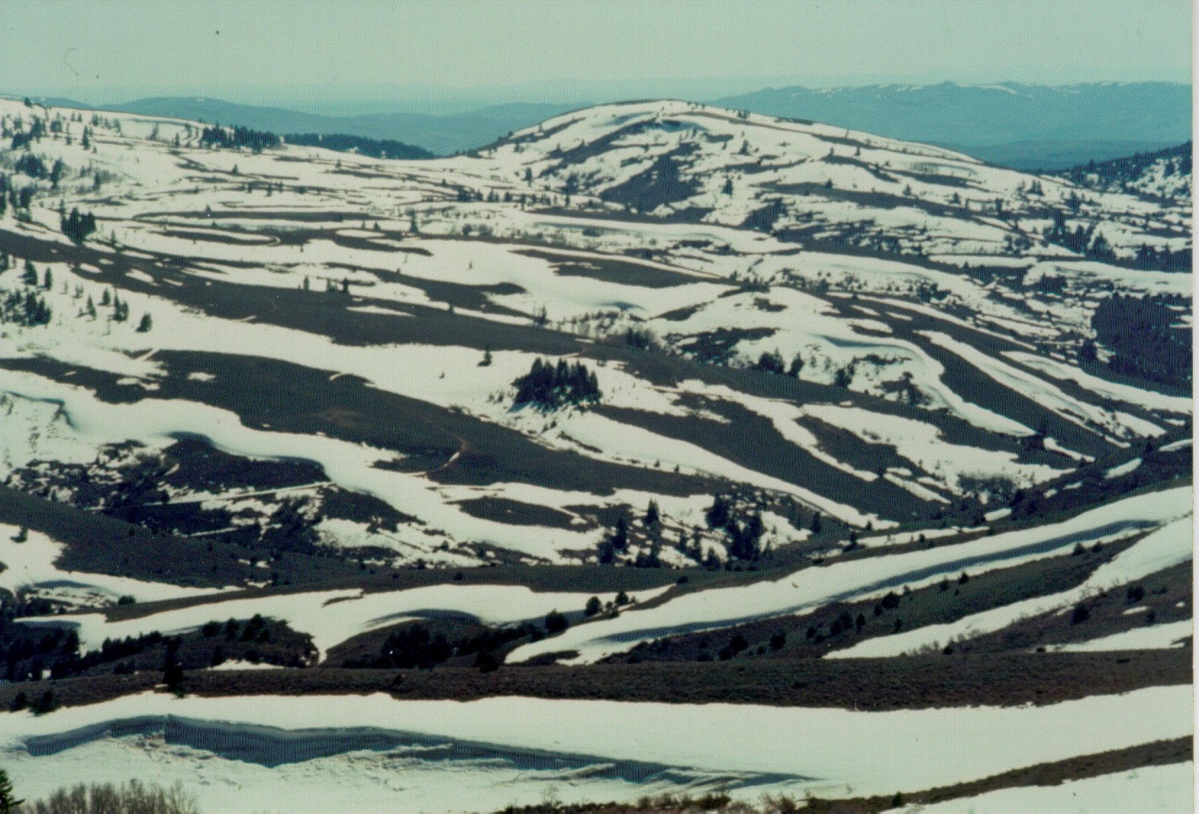
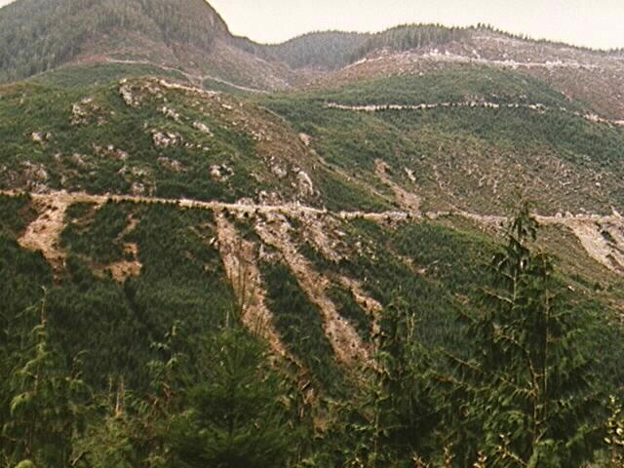
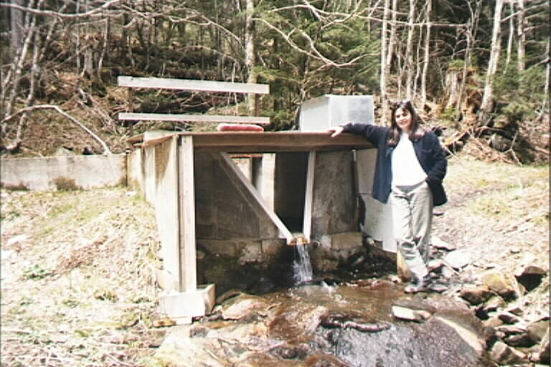
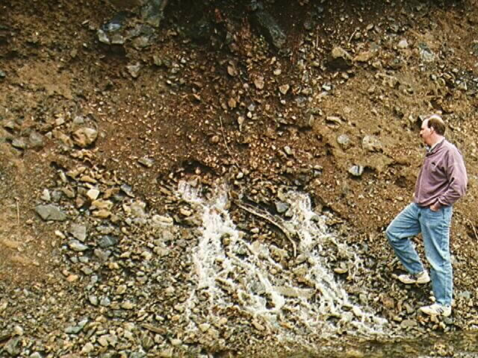
Research
Theme
To advance the capability for hydrologic prediction by developing models that take advantage of new information and process understanding enabled by new technology
Topics
Hydrologic information systems (includes GIS)
Terrain analysis using digital elevation models(watershed delineation)
Snow hydrology
Hydrologic modeling
Streamflow trends
Hydrology and Ecology
Notes:
My research has been pretty varied, but there are a few common themes. The statement "To advance the capability for hydrologic prediction by developing models that take advantage of new information and process understanding enabled by new technology" summarizes my overall goal. The general areas I have worked in are:
Hydrologic information systems (includes GIS)
Terrain analysis using digital elevation models (includes geomorphology)
Snow hydrology
Spatially distributed hydrologic modeling
Stochastic hydrology using nonparametric techniques
I will present some results from the first three of these today.

Slide 3
My Teaching
Physical Hydrology CEE6400 (Fall)
GIS in Water Resources CEE6440 (Fall)
A multi-university course presented on-line with shared video in partnership with David Maidment at the University of Texas at Austin.
Engineering Hydrology CEE3430 (Spring)
Rainfall Runoff Processes (online module)
http://www.engineering.usu.edu/dtarb/rrp.html

Slide 4
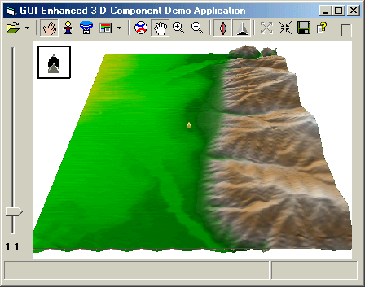

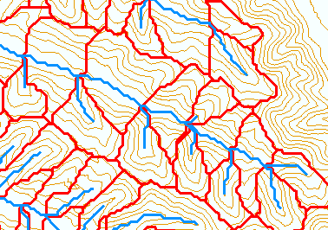
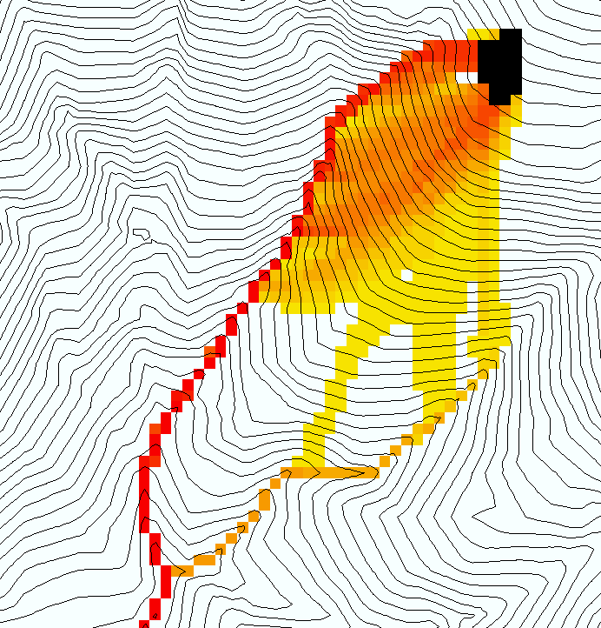
Deriving hydrologically useful information from Digital Elevation Models
Raw DEM
Pit Removal (Filling)
Channels, Watersheds, Flow Related Terrain Information
Flow Field
Watersheds are the most basic hydrologic landscape elements
Notes:
This slide shows the general model for deriving flow field related derivative surfaces from digital elevation data. The input is a raw digital elevation model, generally elevation values on a grid. This is basic information used to derive further hydrology related spatial fields that enrich the information content of this basic data. The first step is to remove sinks, either by filling, or carving. Then a flow field is defined. This enables the calculation of flow related terrain information. My focus has been on flow related information working within this framework. I try to leave other GIS functionality, like radiation exposure, line of sight analyses and visualization to others. I have distributed my software in ways that it easily plugs in to mainstream systems, such as ArcGIS to enhance ease of use.

Slide 5
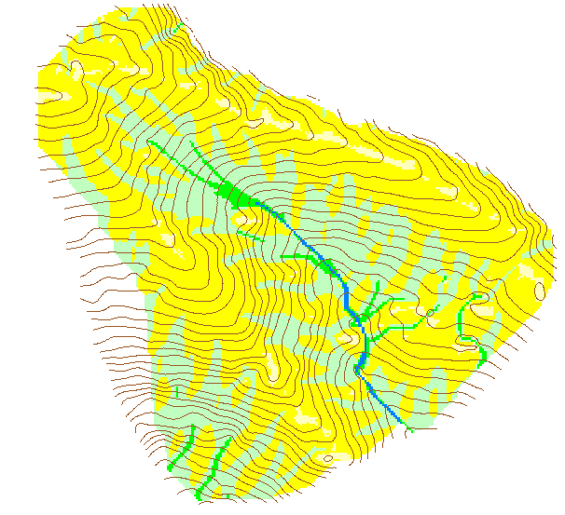
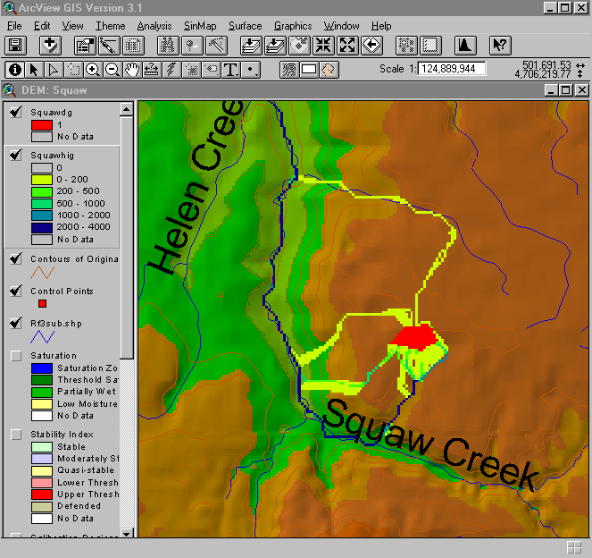
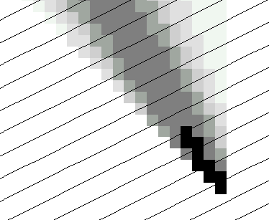
TauDEM - Channel Network and Watershed Delineation Software
Pit removal (standard flooding approach)
Flow directions and slope
D8 (standard)
D∞ (Tarboton, 1997, WRR 33(2):309)
Flat routing (Garbrecht and Martz, 1997, JOH 193:204)
Drainage area (D8 and D∞)
Network and watershed delineation
Support area threshold/channel maintenance coefficient (Standard)
Combined area-slope threshold (Montgomery and Dietrich, 1992, Science, 255:826)
Local curvature based (using Peuker and Douglas, 1975, Comput. Graphics Image Proc. 4:375)
Threshold/drainage density selection by stream drop analysis (Tarboton et al., 1991, Hyd. Proc. 5(1):81)
Other Functions: Downslope Influence, Upslope Dependence, Wetness index, distance to streams, Transport limited accumulation
Developed as C++ command line executable functions
MPICH2 used for parallelization (single program multiple data)
Relies on other software for visualization (ArcGIS Toolbox GUI)

Slide 6
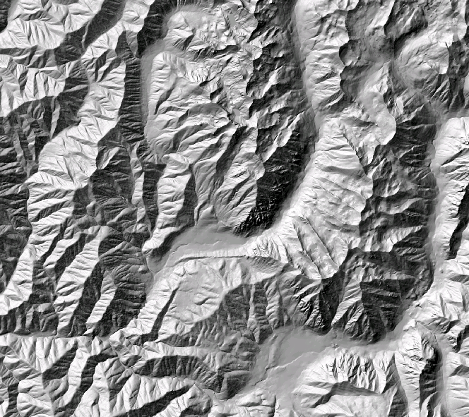
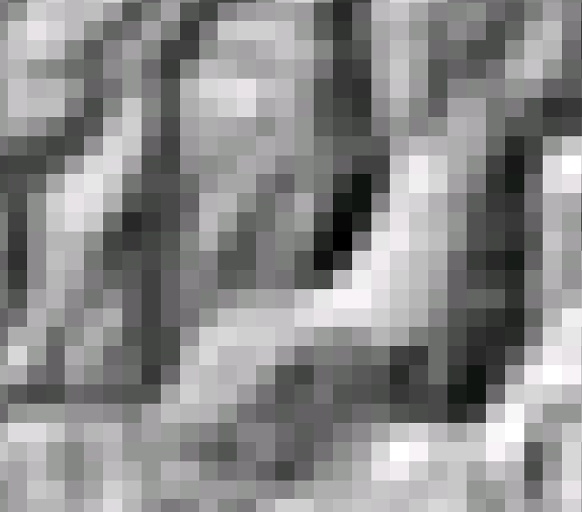
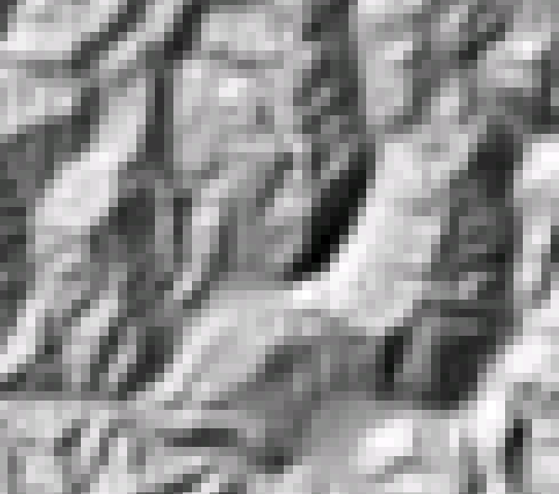
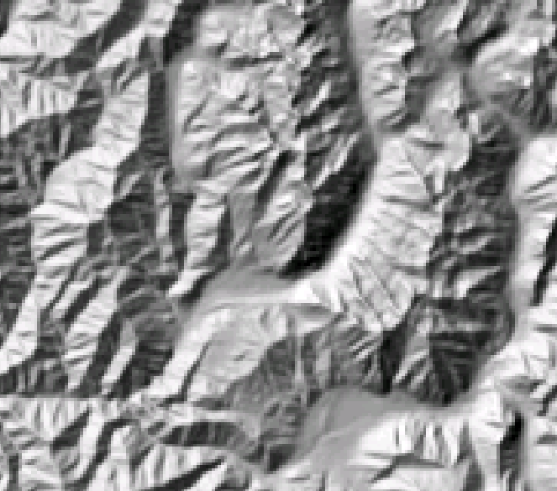
The challenge of increasing Digital Elevation Model (DEM) resolution
1980’s DMA 90 m
10² cells/km²
1990’s USGS DEM 30 m
10³ cells/km²
2000’s NED 10-30 m
10⁴ cells/km²
2010’s LIDAR ~1 m
10⁶ cells/km²

Slide 7
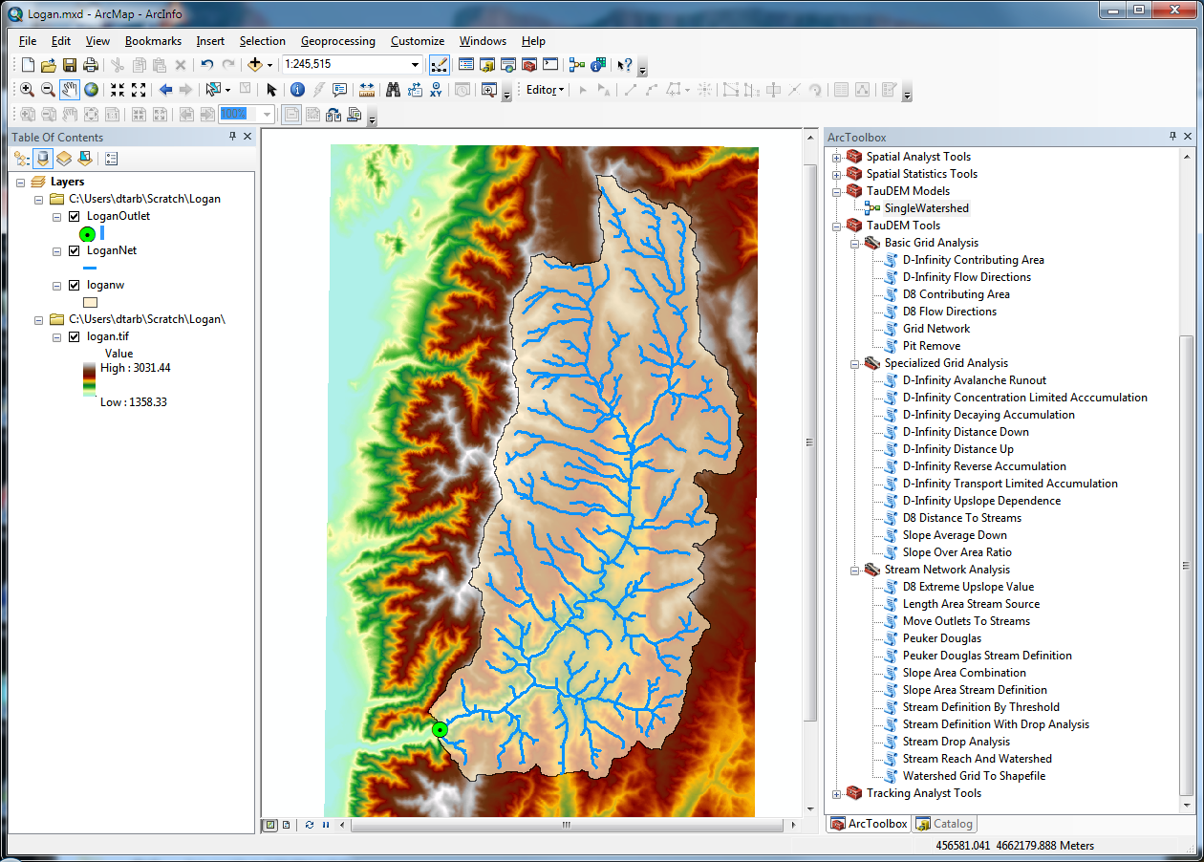
Website and Demo
http://hydrology.usu.edu/taudem

Slide 8
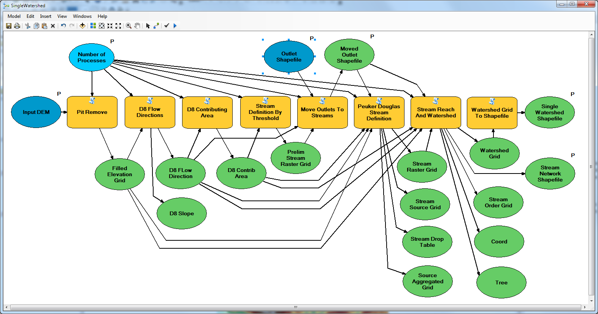
Model Builder Model to Delineate Watershed using TauDEM tools

Slide 9
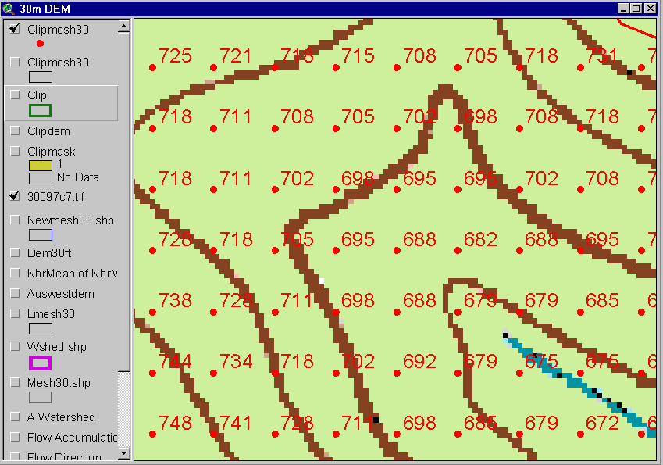
The starting point: A Grid Digital Elevation Model
720
720
Contours
740
720
700
680
740
720
700
680

Slide 10
Grid Data Format Assumptions
Input and output grids are uncompressed GeoTIFF
Maximum size 4 GB
GDAL Nodata tag preferred (if not present, a missing value is assumed)
Grids are square (Δx= Δy)
Grids have identical in extent, cell size and spatial reference
Spatial reference information is not used (no projection on the fly)

Slide 11
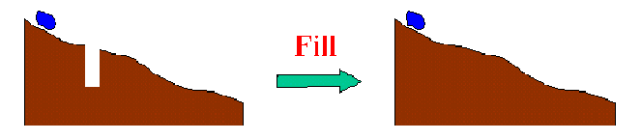
The Pit Removal Problem
DEM creation results in artificial pits in the landscape
A pit is a set of one or more cells which has no downstream cells around it
Unless these pits are removed they become sinks and isolate portions of the watershed
Pit removal is first thing done with a DEM

Slide 12
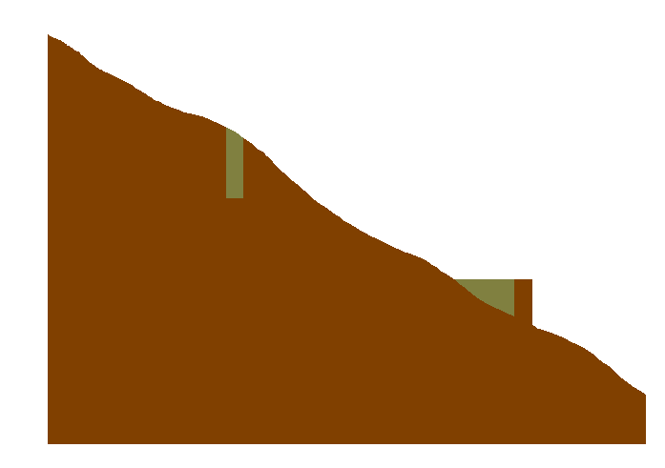

Pit Filling
Increase elevation to the pour point elevation until the pit drains to a neighbor

Slide 13
Pit Filling
Original DEM
Pits Filled
Pits
Pour Points
Notes:
Elevations are filled to that of the pools pour point

Slide 14
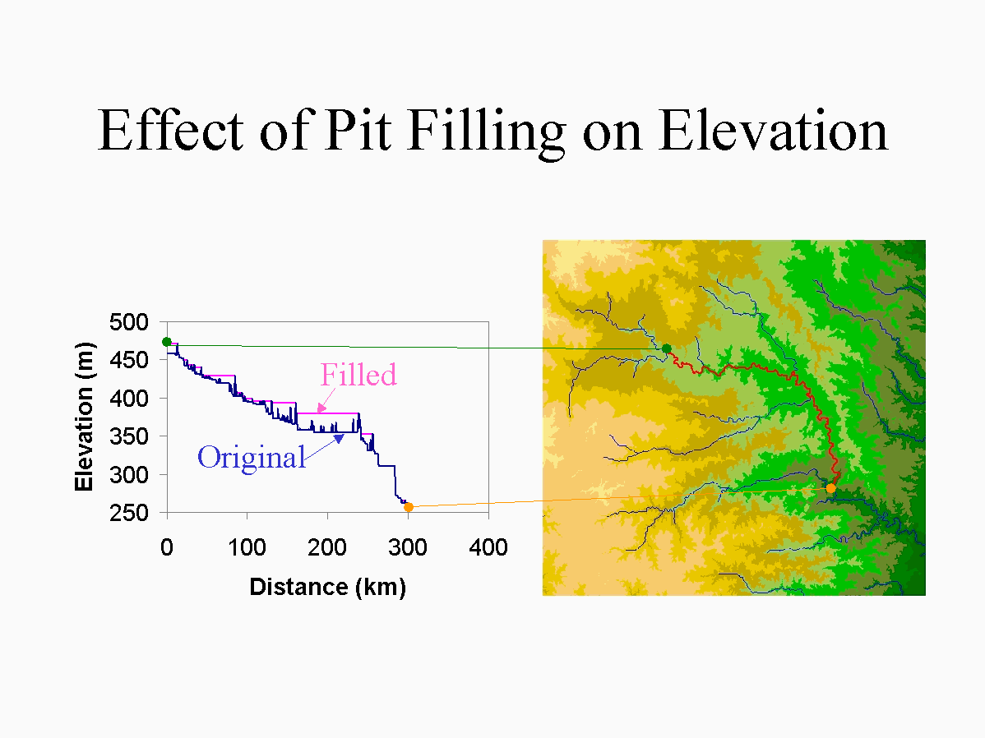

Slide 15
Some Algorithm Details Pit Removal: Planchon Fill Algorithm
Initialization
1st Pass
2nd Pass
Planchon, O., and F. Darboux (2001), A fast, simple and versatile algorithm to fill the depressions of digital elevation models, Catena(46), 159-176.

Slide 16
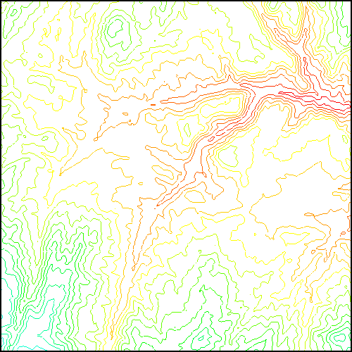
Parallel Approach
MPI, distributed memory paradigm
Row oriented slices
Each process includes one buffer row on either side
Each process does not change buffer row

Slide 17
Parallel Scheme
Communicate
Initialize( Z,F) Do for all grid cells i if Z(i) > n F(i) ← Z(i) Else F(i) ← n i on stack for next pass endfor Send( topRow, rank-1 ) Send( bottomRow, rank+1 ) Recv( rowBelow, rank+1 ) Recv( rowAbove, rank-1 ) Until F is not modified
Z denotes the original elevation.
F denotes the pit filled elevation.
n denotes lowest neighboring elevation
i denotes the cell being evaluated
Iterate only over stack of changeable cells

Slide 18
D8 Flow Direction Model
- Direction of steepest descent
30
80
74
63
4
3
2
69
67
56
5
1
60
52
48
6
7
8
Slope = Drop/Distance
Steepest down slope direction

Slide 19
Grid Network

Slide 20
Contributing Area (Flow Accumulation)
1
1
1
1
1
1
1
1
1
1
1
3
3
3
1
1
3
3
3
1
1
1
11
1
2
1
1
1
2
11
2
1
1
15
1
2
1
1
1
15
1
5
2
20
2
1
5
2
2
20
The area draining each grid cell includes the grid cell itself.

Slide 21
Stream Definition
Flow Accumulation > 10 Cell Threshold
Stream Network for 10 cell Threshold Drainage Area
1
1
1
1
1
1
1
1
1
1
1
3
3
3
1
1
3
3
3
1
1
1
11
1
2
1
1
2
1
11
2
1
1
15
1
2
1
1
1
15
1
5
2
20
2
1
5
2
2
20

Slide 22
Watershed Draining to Outlet

Slide 23
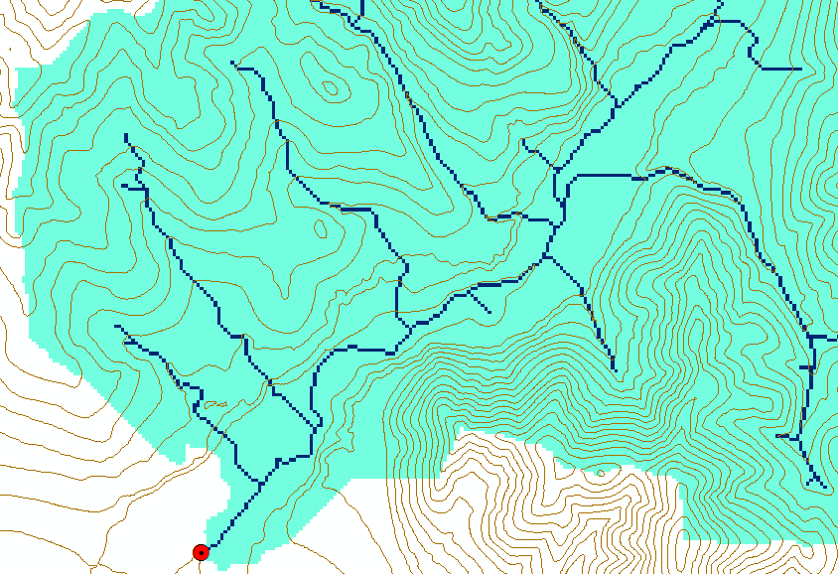
Watershed and Stream Grids

Slide 24
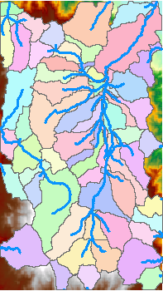
DEM Delineated Catchments and Stream Networks
For every stream segment, there is a corresponding catchment
Catchments are a tessellation of the landscape
Based on the D8 flow direction model

Slide 25
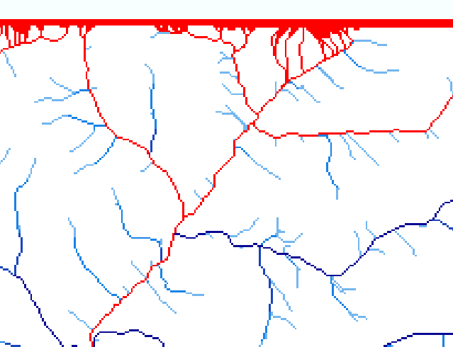
Edge contamination
Edge contamination arises due to the possibility that a contributing area value may be underestimated due to grid cells outside of the domain not being counted. This occurs when drainage is inwards from the boundaries or areas with no data values. The algorithm recognizes this and reports "no data" resulting in streaks of "no data" values extending inwards from boundaries along flow paths that enter the domain at a boundary.

Slide 26
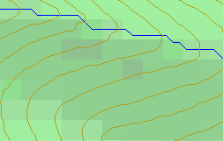
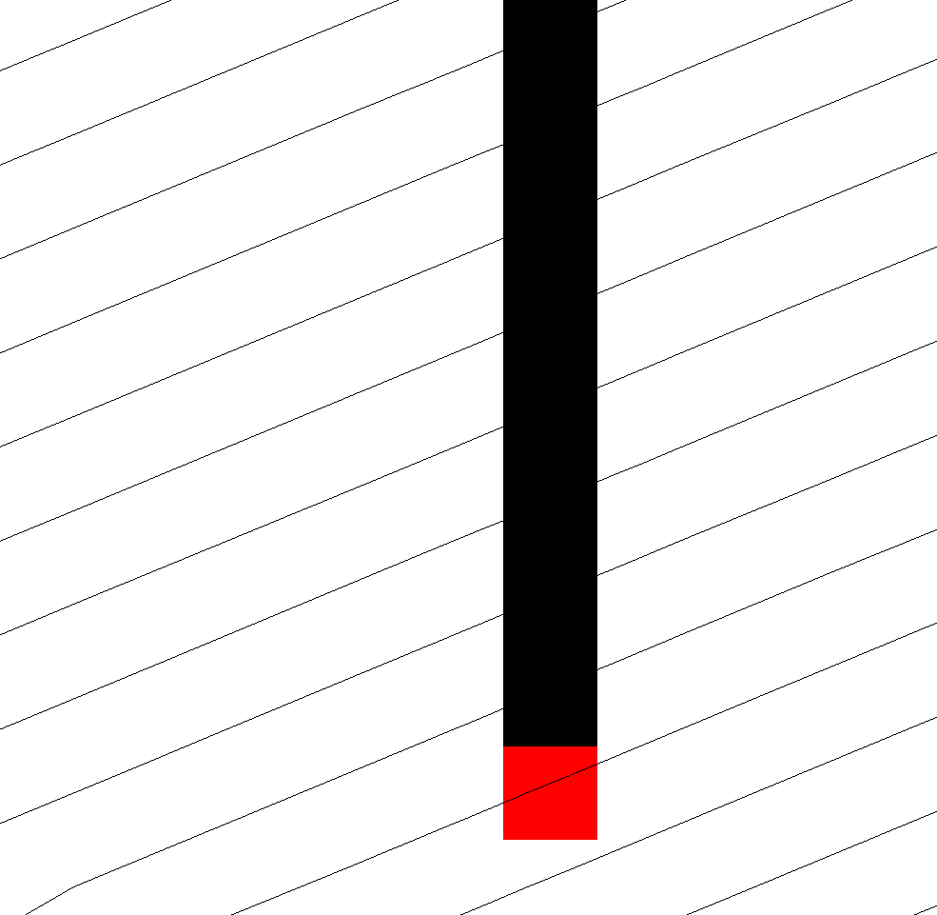
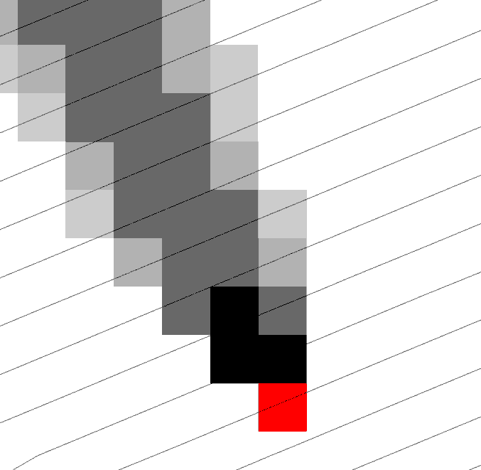
Representation of Flow Field
Steepest single direction
48
52
56
67
D8
D∞
Tarboton, D. G., (1997), "A New Method for the Determination of Flow Directions and Contributing Areas in Grid Digital Elevation Models," Water Resources Research, 33(2): 309-319.)
Notes:
This slide shows how the terrain flow field is represented. Early DEM work used a single flow direction model, D8. In 1997 I published the Dinfinity method that proportions flow from each grid cell among downslope neighbors. This, at the expense of some dispersion, allows a better approximation of flow across surfaces.

Slide 27
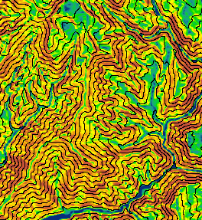
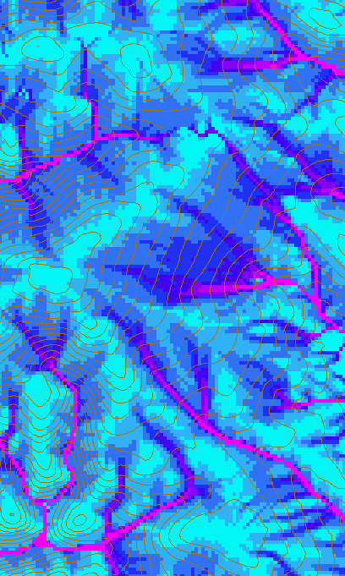
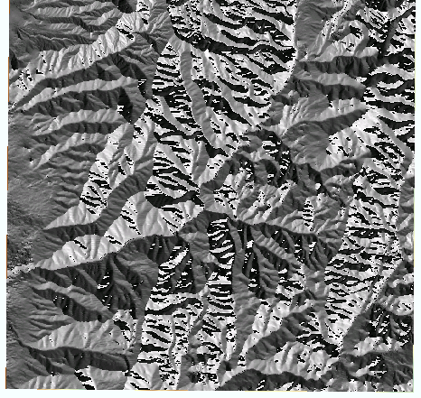
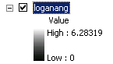
D-Infinity Slope, Flow Direction and Contributing Area

Slide 28
Pseudocode for Recursive Flow Accumulation
Global P, w, A, Δ FlowAccumulation(i) for all k neighbors of i if P_{ki}>0 FlowAccumulation(k) next k return
P_{ki}

Slide 29
General Pseudocode Upstream Flow Algebra Evaluation
Global P, γ, θ FlowAlgebra(i) for all k neighbors of i if P_{ki}>0 FlowAlgebra(k) next k θ_{i} = FA(γ_{i}, P_{ki}, θ_{k}, γ_{k}) return
P_{ki}

Slide 30
Example: Retention limited runoff generation with run-on
Global P, (r,c), q FlowAlgebra(i) for all k neighbors of i if P_{ki}>0 FlowAlgebra(k) next k return
q_{k}
r
q_{i}
c

Slide 31
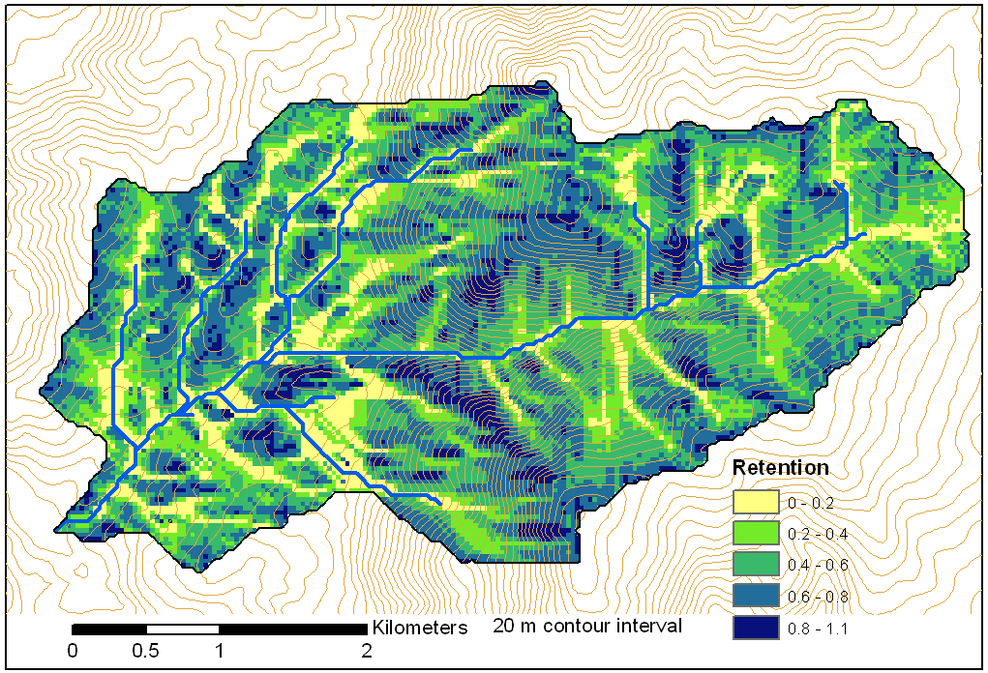
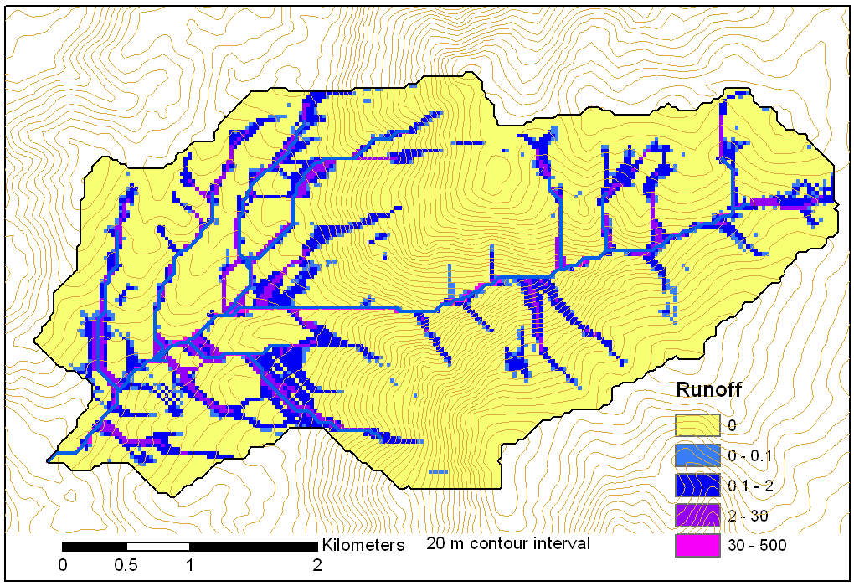
Retention limited runoff with run-on
Retention Capacity
A
C
r=5
c=6
q_{in}=1.8
q=0.8
r=7
c=4
q=3
0.6
1
Runoff from uniform input of 0.25
r=4
c=6
q=0
0.4
r=4
c=5
q_{in}=2
q=1
1
B
D
Notes:
Figure 2 illustrates the evaluation of infiltration capacity limited runoff generation with run on according to (5). Inputs are the r and c values indicated, with the proportional flow directions indicated by the arrows. Grid cells A and B on the left have no dependencies so may be immediately evaluated and using min(r-c,0) result in q=3 and 0 for grid cells A and B respectively. With these evaluated, the unevaluated dependencies of grid cell C become 0, so equation (5) can be evaluated for grid cell C. The inflow is q_{in}=0.6 x 3 = 1.8 from grid cell B. Then q=min(5-6+1.8,0)=0.8. Now all dependencies of D have been evaluated. Inflows from cells A, B, and C, accounting for the proportions are 3 x 0.4 + 0.8 = 2, so the runoff from D is q=min(4-5+2,0)=2.

Slide 32
Useful for a tracking contaminant or compound subject to decay or attenuation

Slide 33
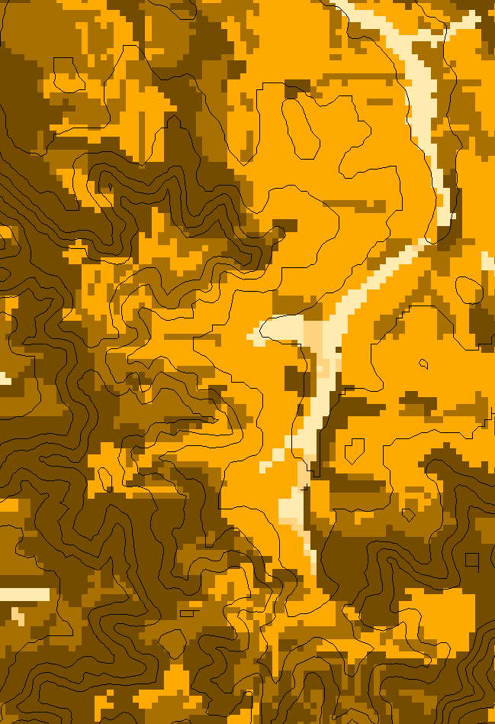
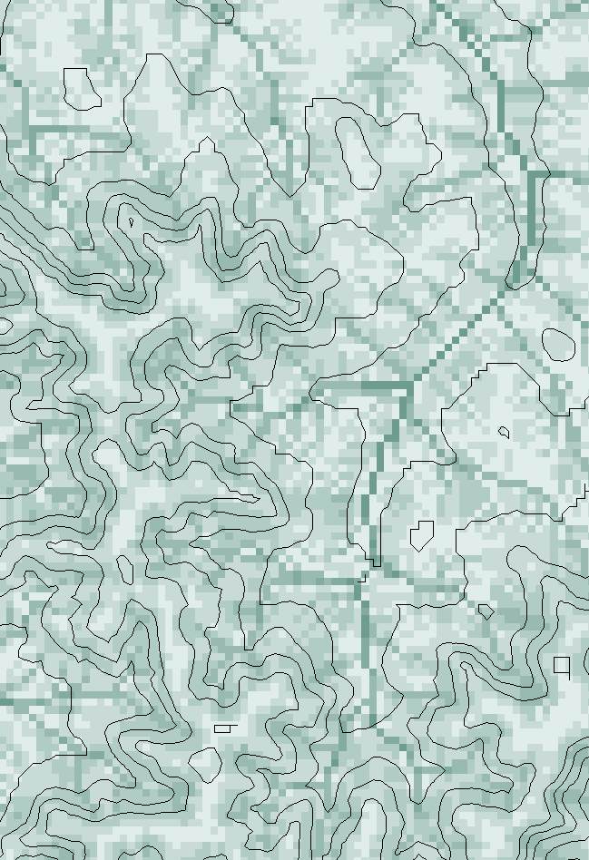
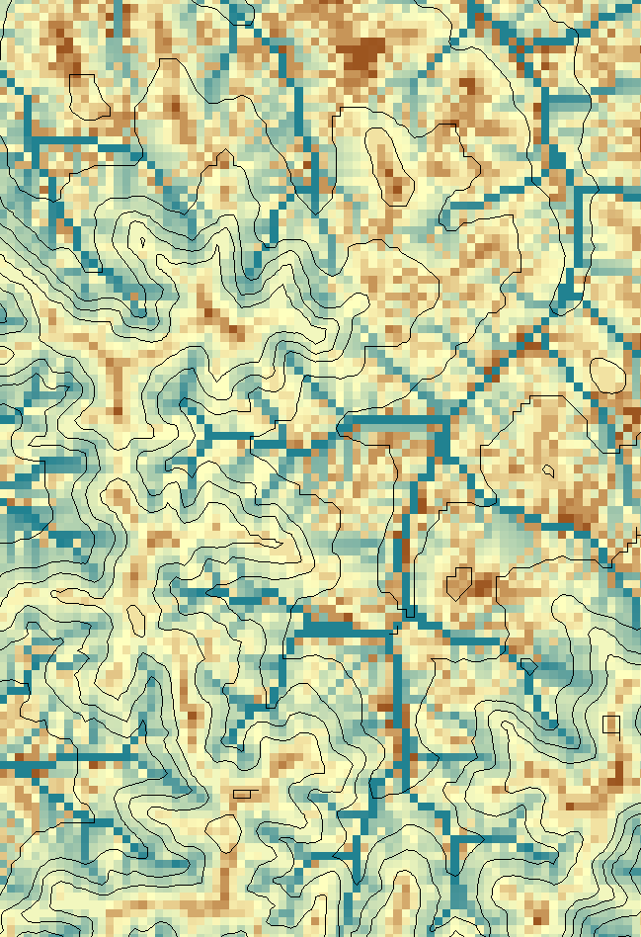
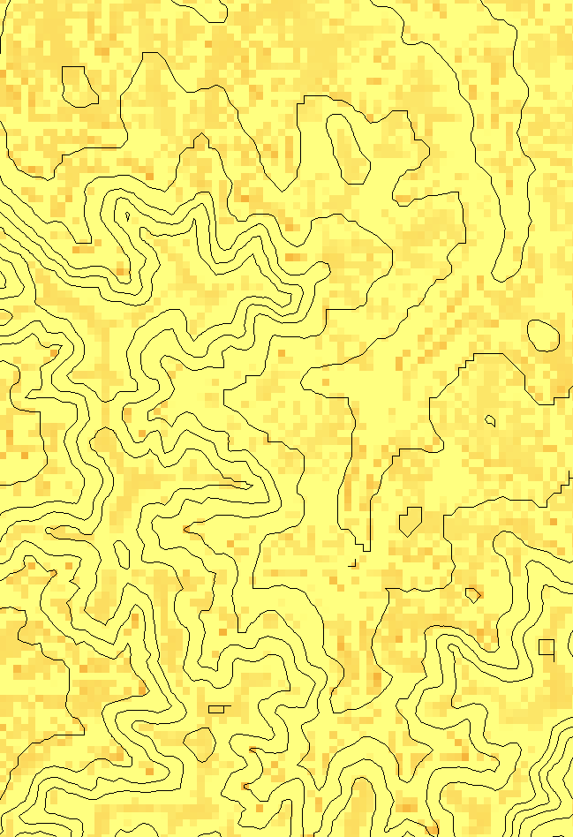
Transport limited accumulation
Supply
Capacity
Transport
Deposition
S
T
=
χa
2
tan(
b
)
2
T
=
min{
S
+
∑
T
,
T
}
D
=
S
+
∑
T
−
T
cap
out
in
cap
in
out
Useful for modeling erosion and sediment delivery, the spatial dependence of sediment delivery ratio and contaminant that adheres to sediment

Slide 34
Parallelization of Contributing Area/Flow Algebra
1. Dependency grid
and so on until completion
resulting in new D=0 cells on queue
Queue’s empty so exchange border info.
Decrease cross partition dependency
Executed by every process with grid flow field P, grid dependencies D initialized to 0 and an empty queue Q. FindDependencies(P,Q,D) for all i for all k neighbors of i if P_{ki}>0 D(i)=D(i)+1 if D(i)=0 add i to Q next
A=1
A=1
A=1
A=1
A=1
A=1
A=1
A=1
D=0
A=1
A=1
A=1
A=1
D=0
D=0
A=1
A=1
A=1
D=0
D=0
A=1
D=0
A=1
A=1
A=1
A=1
A=1
A=1.5
A=1.5
A=3
D=0
A=1.5
A=1.5
D=1
D=0
D=1
D=0
D=0
A=3
D=0
D=3
D=2
D=1
D=0
D=0
D=1
D=1
A=1.5
D=1
A=1.5
A=3
A=3
A=1.5
A=1.5
2. Flow algebra function
B=-2
B=-1
Executed by every process with D and Q initialized from FindDependencies. FlowAlgebra(P,Q,D,θ,γ) while Q isn’t empty get i from Q θ_{i} = FA(γ_{i}, P_{ki}, θ_{k}, γ_{k}) for each downslope neighbor n of i if P_{in}>0 D(n)=D(n)-1 if D(n)=0 add n to Q next n end while swap process buffers and repeat
B=-2
B=-1
A=1
A=1
D=2
D=2
D=1
A=1
D=1
A=1
D=0
A=1
A=1
D=2
D=2
D=2
D=2
D=2
D=1
D=1
D=1
D=1
A=1
D=1
A=1
A=5.5
D=0
A=2.5
D=0
A=1
A=1
D=1
D=1
D=1
A=1
D=1
A=1
D=0
D=0
A=1
D=1
D=1
D=3
D=2
D=1
D=1
D=1
D=1
D=1
A=1
D=1
A=1
D=1
A=6
A=3.5
D=1

Slide 35
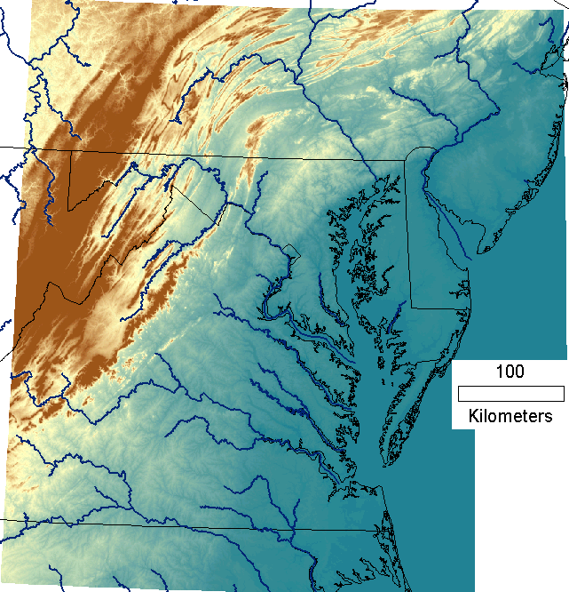
Capabilities Summary
Capability to run larger problems
 |  | Processors used | Grid size
 |  |  | Theoretcal limit | Largest run
2008 | TauDEM 4 | 1 | 0.22 GB | 0.22 GB
Sept 2009 | Partial implement-ation | 8 | 4 GB | 1.6 GB
June 2010 | TauDEM 5 | 8 | 4 GB | 4 GB
Sept 2010 | Multifile on 48 GB RAM PC | 4 | Hardware limits | 6 GB
Sept 2010 | Multifile on cluster with 128 GB RAM | 128 | Hardware limits | 11 GB
11 GB
6 GB
4 GB
1.6 GB
0.22 GB
Single file size limit 4GB
At 10 m grid cell size

Slide 36
Improved runtime efficiency
Parallel Pit Remove timing for NEDB test dataset (14849 x 27174 cells ≈ 1.6 GB).
8 processor PC
Dual quad-core Xeon E5405 2.0GHz PC with 16GB RAM
128 processor cluster
16 diskless Dell SC1435 compute nodes, each with 2.0GHz dual quad-core AMD Opteron 2350 processors with 8GB RAM

Slide 37
Improved runtime efficiency
Parallel D-Infinity Contributing Area Timing for Boise River dataset (24856 x 24000 cells ~ 2.4 GB)
8 processor PC
Dual quad-core Xeon E5405 2.0GHz PC with 16GB RAM
128 processor cluster
16 diskless Dell SC1435 compute nodes, each with 2.0GHz dual quad-core AMD Opteron 2350 processors with 8GB RAM

Slide 38
Scaling of run times to large grids
Dataset | Size | Hardware | Number of Processors | PitRemove (run time seconds) |  | D8FlowDir (run time seconds)
 | (GB) |  |  | Compute | Total | Compute | Total
GSL100 | 0.12 | Owl (PC) | 8 | 10 | 12 | 356 | 358
GSL100 | 0.12 | Rex (Cluster) | 8 | 28 | 360 | 1075 | 1323
GSL100 | 0.12 | Rex (Cluster) | 64 | 10 | 256 | 198 | 430
GSL100 | 0.12 | Mac | 8 | 20 | 20 | 803 | 806
YellowStone | 2.14 | Owl (PC) | 8 | 529 | 681 | 4363 | 4571
YellowStone | 2.14 | Rex (Cluster) | 64 | 140 | 3759 | 2855 | 11385
Boise River | 4 | Owl (PC) | 8 | 4818 | 6225 | 10558 | 11599
Boise River | 4 | Virtual (PC) | 4 | 1502 | 2120 | 10658 | 11191
Bear/Jordan/Weber | 6 | Virtual (PC) | 4 | 4780 | 5695 | 36569 | 37098
Chesapeake | 11.3 | Rex (Cluster) | 64 | 702 | 24045
Owl is an 8 core PC (Dual quad-core Xeon E5405 2.0GHz) with 16GB RAM
Rex is a 128 core cluster of 16 diskless Dell SC1435 compute nodes, each with 2.0GHz dual quad-core AMD Opteron 2350 processors with 8GB RAM
Virtual is a virtual PC resourced with 48 GB RAM and 4 Intel Xeon E5450 3 GHz processors
Mac is an 8 core (Dual quad-core Intel Xeon E5620 2.26 GHz) with 16GB RAM

Slide 39
Scaling of run times to large grids
Owl is an 8 core PC (Dual quad-core Xeon E5405 2.0GHz) with 16GB RAM
Rex is a 128 core cluster of 16 diskless Dell SC1435 compute nodes, each with 2.0GHz dual quad-core AMD Opteron 2350 processors with 8GB RAM
Virtual is a virtual PC resourced with 48 GB RAM and 4 Intel Xeon E5450 3 GHz processors

Slide 40
Programming
C++ Command Line Executables that use MPICH2
ArcGIS Python Script Tools
Python validation code to provide file name defaults
Shared as ArcGIS Toolbox

Slide 41
Q based block of code to evaluate any “flow algebra expression”
while(!que.empty())
{
//Takes next node with no contributing neighbors
temp = que.front(); que.pop();
i = temp.x; j = temp.y;
// FLOW ALGEBRA EXPRESSION EVALUATION
if(flowData->isInPartition(i,j)){
float areares=0.; // initialize the result
for(k=1; k<=8; k++) { // For each neighbor
in = i+d1[k]; jn = j+d2[k]; flowData->getData(in,jn, angle);
p = prop(angle, (k+4)%8);
if(p>0.){
if(areadinf->isNodata(in,jn))con=true;
else{
areares=areares+p*areadinf->getData(in,jn,tempFloat);
}
}
}
}
// Local inputs
areares=areares+dx;
if(con && contcheck==1)
areadinf->setToNodata(i,j);
else
areadinf->setData(i,j,areares);
// END FLOW ALGEBRA EXPRESSION EVALUATION
}

Slide 42
Maintaining to do Q and partition sharing
while(!finished) { //Loop within partition
while(!que.empty())
{ .... // FLOW ALGEBRA EXPRESSION EVALUATION
}
// Decrement neighbor dependence of downslope cell
flowData->getData(i, j, angle);
for(k=1; k<=8; k++) {
p = prop(angle, k);
if(p>0.0) {
in = i+d1[k]; jn = j+d2[k];
//Decrement the number of contributing neighbors in neighbor
neighbor->addToData(in,jn,(short)-1);
//Check if neighbor needs to be added to que
if(flowData->isInPartition(in,jn) && neighbor->getData(in, jn, tempShort) == 0 ){
temp.x=in; temp.y=jn;
que.push(temp);
}
}
}
}
//Pass information across partitions
areadinf->share();
neighbor->addBorders();

Slide 43
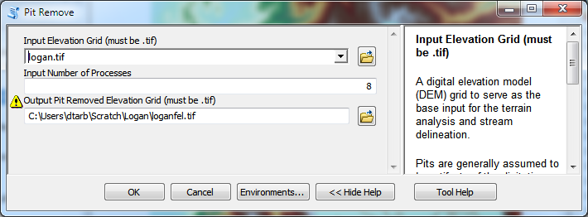
Python Script to Call Command Line
mpiexec –n 8 pitremove –z Logan.tif –fel Loganfel.tif

Slide 44
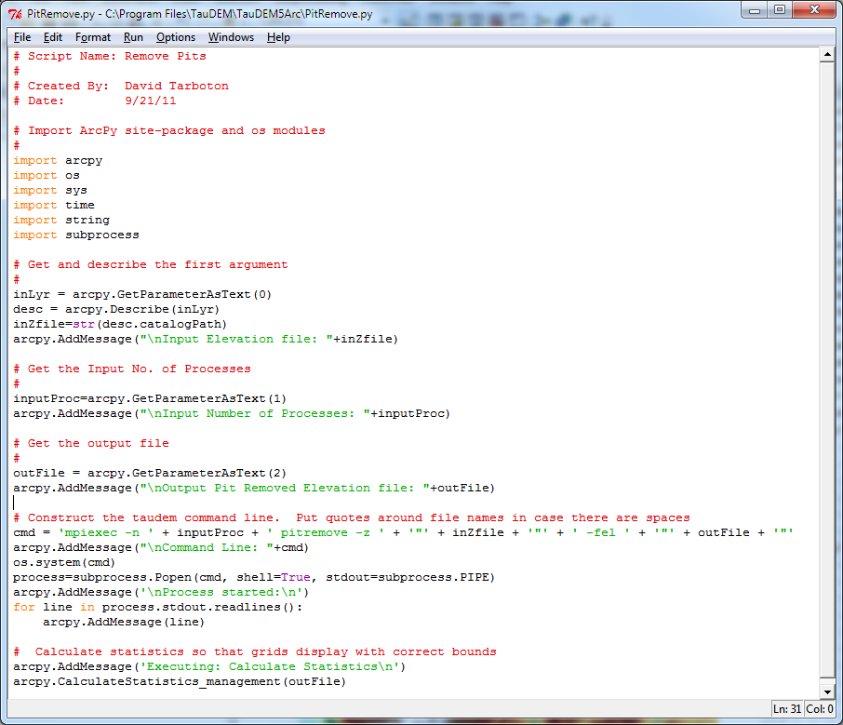
PitRemove

Slide 45
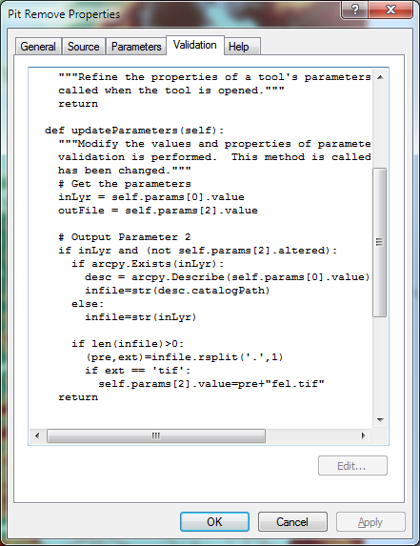
Validation code to add default file names

Slide 46
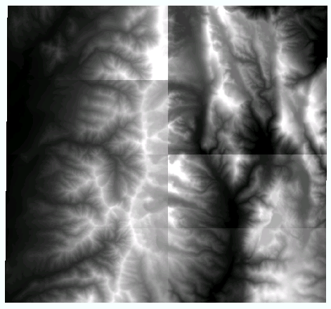
Multi-File approach
To overcome 4 GB file size limit
To avoid bottleneck of parallel reads to network files
What was a file input to TauDEM is now a folder input
All files in the folder tiled together to form large logical grid

Slide 47
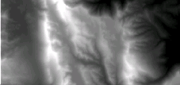
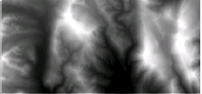
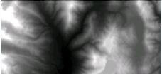
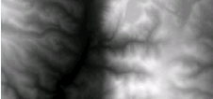
Processor Specific Multi-File Strategy
Input
Output
Shared file store
Node 1 local disk
Node 1 local disk
Shared file store
Core 1
Core 2
Node 2 local disk
Node 2 local disk
Core 1
Scatter all input files to all nodes
Gather partial output from each node to form complete output on shared store
Core 2

Slide 48
Summary and Conclusions
Parallelization speeds up processing and partitioned processing reduces size limitations
Parallel logic developed for general recursive flow accumulation methodology (flow algebra)
Documented ArcGIS Toolbox Graphical User Interface
32 and 64 bit versions (but 32 bit version limited by inherent 32 bit operating system memory limitations)
PC, Mac and Linux/Unix capability
Capability to process large grids efficiently increased from 0.22 GB upper limit pre-project to where < 4GB grids can be processed in the ArcGIS Toolbox version on a PC within a day and up to 11 GB has been processed on a distributed cluster (a 50 fold size increase)

Slide 49
Limitations and Dependencies
Uses MPICH2 library from Argonne National Laboratory http://www.mcs.anl.gov/research/projects/mpich2/
TIFF (GeoTIFF) 4 GB file size (for single file version)
Run multifile version from command line for > 4 GB datasets
Processor memory

